Slide 1
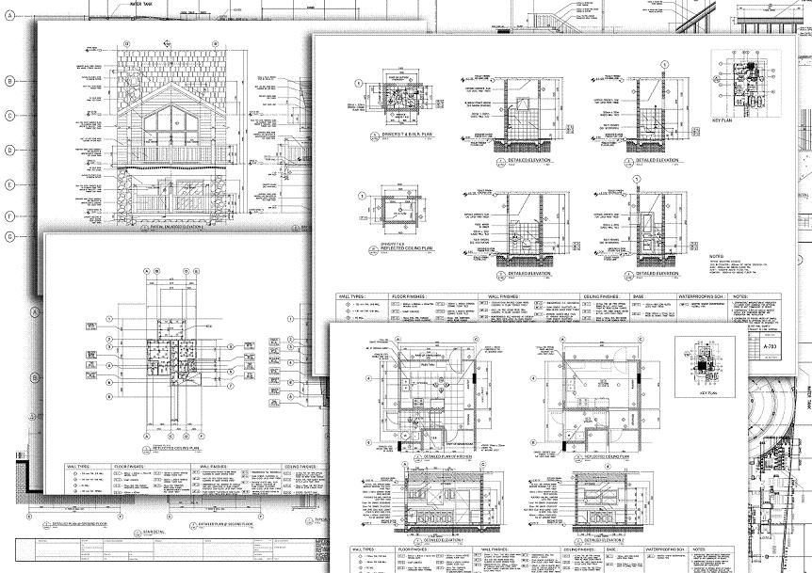
Drawing Document Essentials
Presenter
Developer Technical Services

Slide 2
Agenda
Drawing Definition Objects
Drawing View
Drawing Curves
Drawing Dimensions
Lab: Drawing Document

Slide 3
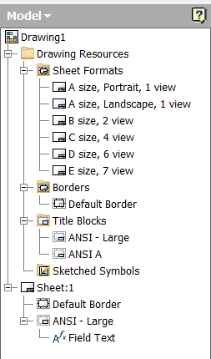
Drawing Definition Objects
BorderDefinitions
TitleBlockDefinitions
SketchedSymbol

Slide 4
Create new TitleBlockDefinition
Public Sub AddTitleBlockDef()
'Ensures the active document is a drawing
If Not TypeOf _InvApplication.ActiveDocument Is DrawingDocument Then
MsgBox("A Drawing Document must be active...")
Exit Sub
End If
Dim oDrawDoc As DrawingDocument
oDrawDoc = _InvApplication.ActiveDocument
' get the Title blocks (definitions)
Dim oTitleBlks As TitleBlockDefinitions
oTitleBlks = oDrawDoc.TitleBlockDefinitions
' add a new title block definition
Dim oTitleBlk As TitleBlockDefinition
oTitleBlk = oTitleBlks.Add("My TitleBlock")
End Sub
Notes:
'/////////////////////////////////////////////////////////////////////////////////////////////////////////////
'// Sample
'//
'// Use: Create a empty Title Block Definition
'/////////////////////////////////////////////////////////////////////////////////////////////////////////////
Public Sub AddTitleBlockDef()
'Ensures the active document is a drawing
If _InvApplication.ActiveDocument.DocumentType <> DocumentTypeEnum.kDrawingDocumentObject Then
MsgBox("A Drawing Document must be active...")
Exit Sub
End If
Dim oDrawDoc As DrawingDocument
oDrawDoc = _InvApplication.ActiveDocument
' get the Title blocks (definitions)
Dim oTitleBlks As TitleBlockDefinitions
oTitleBlks = oDrawDoc.TitleBlockDefinitions
' add a new title block definition
Dim oTitleBlk As TitleBlockDefinition
oTitleBlk = oTitleBlks.Add("My TitleBlock")
End Sub

Slide 5
Create/Edit BorderDefinition
Public Sub CreateBorderDefinition()
Dim oDrawDoc As DrawingDocument
oDrawDoc = _InvApplication.ActiveDocument
' Create the new border definition.
Dim oBorderDef As BorderDefinition
oBorderDef = oDrawDoc.BorderDefinitions.Add("My Border")
' Open the border definition's sketch for edit. This is done by calling
' Edit method of the BorderDefinition to obtain a DrawingSketch.
Dim oSketch As DrawingSketch = Nothing
Call oBorderDef.Edit(oSketch)
Dim oTG As TransientGeometry
oTG = _InvApplication.TransientGeometry
' Use the functionality of the sketch to add geometry.
Call oSketch.SketchLines.AddAsTwoPointRectangle(_
oTG.CreatePoint2d(2, 2), _
oTG.CreatePoint2d(53.88, 41.18))
Call oBorderDef.ExitEdit(True)
End Sub
Notes:
'/////////////////////////////////////////////////////////////////////////////////////////////////////////////
'// Sample
'//
'// Use: Create a Border Definition
'/////////////////////////////////////////////////////////////////////////////////////////////////////////////
Public Sub CreateBorderDefinition()
Dim oDrawDoc As DrawingDocument
oDrawDoc = _InvApplication.ActiveDocument
' Create the new border definition.
Dim oBorderDef As BorderDefinition
oBorderDef = oDrawDoc.BorderDefinitions.Add("My Border")
' Open the border definition's sketch for edit. This is done by calling the Edit
' method of the BorderDefinition to obtain a DrawingSketch.
Dim oSketch As DrawingSketch = Nothing
Call oBorderDef.Edit(oSketch)
Dim oTG As TransientGeometry
oTG = _InvApplication.TransientGeometry
' Use the functionality of the sketch to add geometry.
Call oSketch.SketchLines.AddAsTwoPointRectangle(oTG.CreatePoint2d(2, 2), oTG.CreatePoint2d(53.88, 41.18))
Call oBorderDef.ExitEdit(True)
End Sub

Slide 6
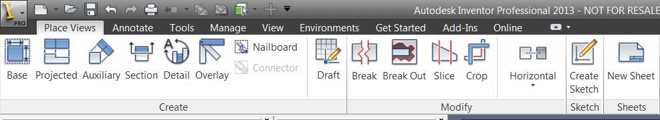
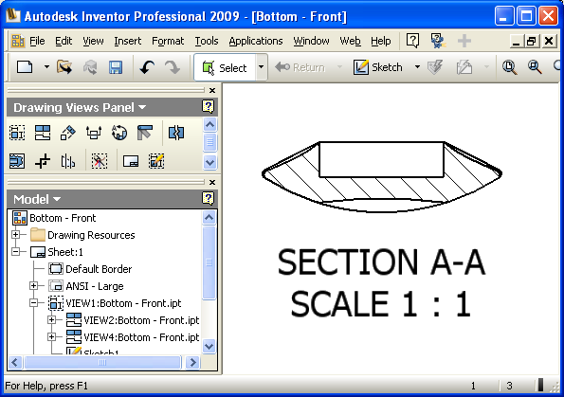
Drawing Views – API Support
Base, projected, auxiliary, section, detail, overlay, draft , break and breakout views can be created
The other view queried and edited as a general view
Style control over drawing entities (weight, type, etc.)
Full access to the drawing view label
Allows to control the visibility of the view by suppress/unsuppress
Notes:
Green Views are supported by API, Yellow ones as well and were added in 2010 release

Slide 7
View Creation - Example
Public Sub CreateViews()
Dim oDrawingDoc As DrawingDocument
oDrawingDoc = _InvApplication.ActiveDocument
'Open a Part model to create a view for, invisibly
Dim oPartDoc As PartDocument
oPartDoc = _InvApplication.Documents.Open("C:\Temp\Part1.ipt", False)
Dim oTG As TransientGeometry = _InvApplication.TransientGeometry
Dim oSheet As Sheet = oDrawingDoc.ActiveSheet
' Create the base view.
Dim oFrontView As DrawingView
oFrontView = oSheet.DrawingViews.AddBaseView(oPartDoc, _
oTG.CreatePoint2d(35, 20), 1, _
ViewOrientationTypeEnum.kFrontViewOrientation, _
DrawingViewStyleEnum.kHiddenLineDrawingViewStyle)
' Create projected views.
Dim oRightView As DrawingView
oRightView = oSheet.DrawingViews.AddProjectedView(oFrontView, _
oTG.CreatePoint2d(15, 20), _
DrawingViewStyleEnum.kFromBaseDrawingViewStyle)
Dim oIsoView As DrawingView
oIsoView = oSheet.DrawingViews.AddProjectedView(oFrontView, _
oTG.CreatePoint2d(15, 35), _
DrawingViewStyleEnum.kHiddenLineRemovedDrawingViewStyle)
End Sub
Notes:
'/////////////////////////////////////////////////////////////////////////////////////////////////////////////
'// Sample
'//
'// Use: Create Drawing Views
'/////////////////////////////////////////////////////////////////////////////////////////////////////////////
Public Sub CreateViews()
Dim oDrawingDoc As DrawingDocument
oDrawingDoc = _InvApplication.ActiveDocument
Dim oPartDoc As PartDocument
oPartDoc = _InvApplication.Documents.Open("C:\Temp\Part1.ipt", False)
Dim oTG As TransientGeometry
oTG = _InvApplication.TransientGeometry
' Create the base view.
Dim oFrontView As DrawingView
oFrontView = oDrawingDoc.ActiveSheet.DrawingViews.AddBaseView(oPartDoc, oTG.CreatePoint2d(35, 20), 1, _
ViewOrientationTypeEnum.kFrontViewOrientation, _
DrawingViewStyleEnum.kHiddenLineDrawingViewStyle)
' Create projected views.
Dim oRightView As DrawingView
oRightView = oDrawingDoc.ActiveSheet.DrawingViews.AddProjectedView(oFrontView, oTG.CreatePoint2d(15, 20), _
DrawingViewStyleEnum.kFromBaseDrawingViewStyle)
Dim oIsoView As DrawingView
oIsoView = oDrawingDoc.ActiveSheet.DrawingViews.AddProjectedView(oFrontView, oTG.CreatePoint2d(15, 35), _
DrawingViewStyleEnum.kHiddenLineRemovedDrawingViewStyle)
End Sub
'/////////////////////////////////////////////////////////////////////////////////////////////////////////////
'// Sample
'//
'// Use: BaseView with model Camera
'/////////////////////////////////////////////////////////////////////////////////////////////////////////////
Sub CreateBaseViewWithCamera()
'Open the part to insert in the drawing (Visible mode is required).
Dim oPartDoc As PartDocument
Set oPartDoc = ThisApplication.Documents.Open("C:\Temp\Part1.ipt", True)
'Get Camera object
Dim oCamera As Camera
Set oCamera = ThisApplication.ActiveView.Camera
'Set your Camera parameters
oCamera.Eye = ThisApplication.TransientGeometry.CreatePoint(0, 10, 10)
oCamera.target = ThisApplication.TransientGeometry.CreatePoint(0, 0, 0)
oCamera.UpVector = ThisApplication.TransientGeometry.CreateUnitVector(0, 1, 0)
'Open the Drawing doc
Dim oDrawingDoc As DrawingDocument
Set oDrawingDoc = ThisApplication.Documents.Open("C:\Temp\Drawing1.idw", True)
Dim oSheet As sheet
Set oSheet = oDrawingDoc.Sheets.item(1)
'Position base view in middle of the sheet
Dim oViewPos As point2d
Set oViewPos = ThisApplication.TransientGeometry.CreatePoint2d(oSheet.width / 2, oSheet.height / 2)
'Create view with parameters
Dim oBaseView As DrawingView
Set oBaseView = oSheet.DrawingViews.AddBaseView(oPartDoc, oViewPos, 1, kArbitraryViewOrientation, kHiddenLineDrawingViewStyle, "BaseView1", oCamera)
'Close the part doc
oPartDoc.Close
End Sub

Slide 8
Associative Draft Views
View type that is only exposed through the API.
An associative draft view is a combination of a draft view and a standard drawing view.
An associative draft view can only contain sketches and does not display any model geometry.
An associative draft view has a reference to a part, assembly, or presentation document.
Sub AddAssociativeDraftView(Model As Document, Position As Point2d, ByRef Scale As [defaultvalue(1.0)] double, ByRef Name As [defaultvalue("")] BSTR, Result As [out, retval] DrawingView*)
Notes:
Allows the associated document to automatically be handled by data management software since it is seen as a reference of the drawing.
Events notification indicating when the associated model has changed and the view contents (sketch) should be updated. This is the key part. Added for harness.

Slide 9
Drawing Curves
The API provides access to the geometry that’s created when you create a view of a part or assembly.
The drawing curves are created by constructing a cleaned up representation of the 3d model.
The corresponding model edge or face is available from the curve.

Slide 10
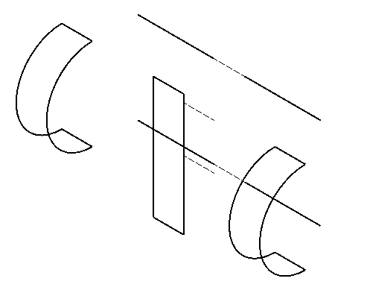
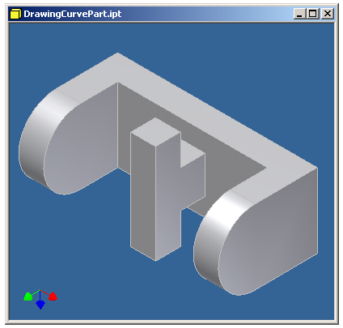
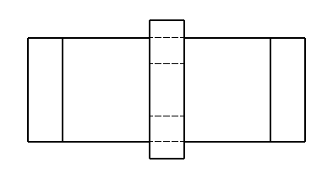
Drawing Curves
Can access all curves in the view or just the curves that represent a specific model edge or face.
DrawingView.DrawingCurves([ModelObject]) As
DrawingCurvesEnumerator
Returns Nothing if the model edge or face is not represented in the drawing.
Selections return DrawingCurveSegment objects.

Slide 11
Drawing Curves
DrawingCurveSegment
represents a single segment of a drawing curve
GeometryType (provided from 2013): returns the type of the geometry object that will be returned by the Geometry property.
Geometry (provided from 2013): returns a 2d geometry object that represents this drawing curve segment in sheet space. The true drawing curve is 3d geometry and this is a flattened 2d version. As a result the geometry type can be different. For example a 3d circle can flatten to a 2d ellipse or a line if the circle is viewed completely on edge. There isn’t any expected correlation between the parameterization of this curve and the original 3d curve.

Slide 12
GeometryIntent Objects
Sheet.CreateGeometryIntent(Geometry As Object, [Intent])
As GeometryIntent
Geometry
Object that specifies the geometry. Valid input objects are DrawingCurve, all the drawing sketch entities, DrawingDimension, Centerline, Centermark and Point2d.
Intent
Optional input object that specifies the intent point on the input geometry. This can be a value from PointIntentEnum, an linear entity if the intent is the intersection of two entities, a Point2d object that specifies a point (in sheet space) on the geometry or a double value indicating the parameter on the input curve geometry

Slide 13
DrawingCurves as Input/Output
Drawing curves can be provided as input when creating drawing annotation.
DrawingCurve is usually required in positioning the annotation objects along the curve.
GeometryIntent objects are used as input and output when working with drawing annotation objects.
The GeometryIntent object defines a drawing curve and a position on the curve.
Notes:
Drawing curves can be provided as input when creating drawing annotation and are provided as part of the output when querying existing annotations.

Slide 14
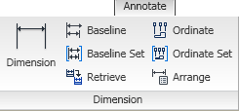
Dimensions
DrawingDimension is the base class for all dimension types.
Represented as each individual dimension
Creation of baseline, ordinate and ordinate dimension sets.
Model and sketch dimensions can be "retrieved" to create general dimensions (GeneralDimensions.Retrieve)
Notes:
'/////////////////////////////////////////////////////////////////////////////////////////////////////////////
'// Sample
'//
'// Use: Retrieve dimensions from model sketches
'/////////////////////////////////////////////////////////////////////////////////////////////////////////////
Public Sub RetrievDimensionsFromModel()
Dim oDrawing As DrawingDocument
oDrawing = _InvApplication.ActiveDocument
Dim oView As DrawingView
oView = oDrawing.ActiveSheet.DrawingViews(1)
Dim oDimColl As GeneralDimensionsEnumerator
oDimColl = oDrawing.ActiveSheet.DrawingDimensions.GeneralDimensions.Retrieve(oView)
End Sub

Slide 15
Creating Dimensions - Example
' Get two edges from the model.
Dim oEdge1 As Edge
Dim oEdge2 As Edge
oEdge1 = oPartDef.SurfaceBodies.Item(1).Edges.Item(5)
oEdge2 = oPartDef.SurfaceBodies.Item(1).Edges.Item(11)
' Get the drawing curves that are associated with the edges.
' This will return Nothing if the edges aren't shown in the drawing.
Dim oCurves1 As DrawingCurvesEnumerator
Dim oCurves2 As DrawingCurvesEnumerator
oCurves1 = oView.DrawingCurves(oEdge1)
oCurves2 = oView.DrawingCurves(oEdge2)
' Create GeometryIntent objects for start/end points on the curves.
Dim oIntent1 As GeometryIntent
Dim oIntent2 As GeometryIntent
oIntent1 = osheet.CreateGeometryIntent(oCurves1.Item(1), PointIntentEnum.kEndPointIntent)
oIntent2 = osheet.CreateGeometryIntent(oCurves2.Item(1), PointIntentEnum.kStartPointIntent)
' Create a linear dimension
Dim oDim As LinearGeneralDimension
oDim = osheet.DrawingDimensions.GeneralDimensions.AddLinear(oTG.CreatePoint2d(8, 16), _
oIntent1, oIntent2, DimensionTypeEnum.kVerticalDimensionType)
' Create a GeometryIntent object that just defined the entity and no point.
Dim oIntent3 As GeometryIntent
oIntent3 = oSheet.CreateGeometryIntent(oCurves2.Item(1))
' Create a dimension to the single entity.
oDim = osheet.DrawingDimensions.GeneralDimensions.AddLinear(oTG.CreatePoint2d(15, 23), _
oIntent3, , DimensionTypeEnum.kHorizontalDimensionType)

Slide 16
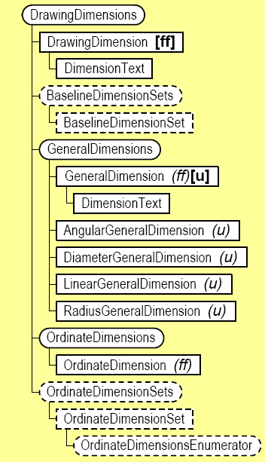
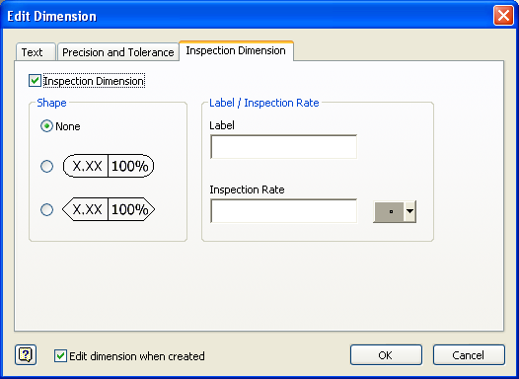
Dimensions
Can determine the status of a dimension, (i.e. detached).
Access dimension and extension lines of a dimension to attach annotations
Support for inspection related information on dimensions

Slide 17
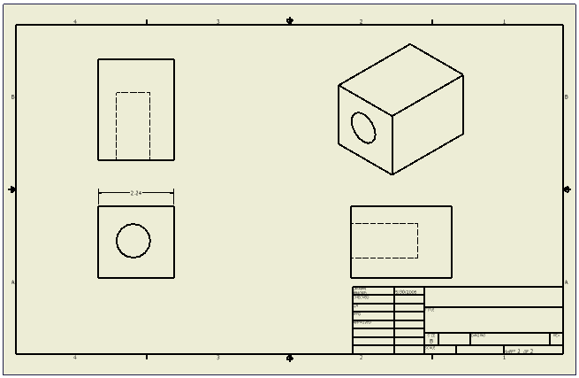
Lab 8 – Drawing Document
Write a .Net program to:
Create a new B size sheet.
Add a default border.
Add an "ANSI A" title block.
Place front, right, top, and isometric views of the "block" part.
Place a dimension to the top edge of the block in the front view.

Slide 18

Notes:
Thank you!
Questions?

